Slide 1

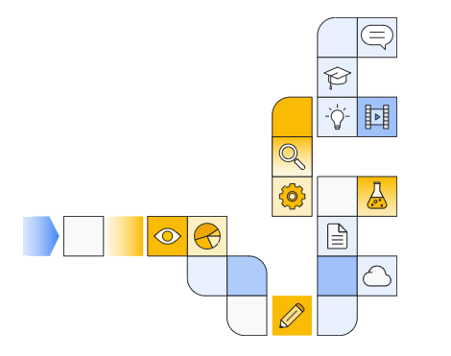

Understanding skills boost courses

Slide 2
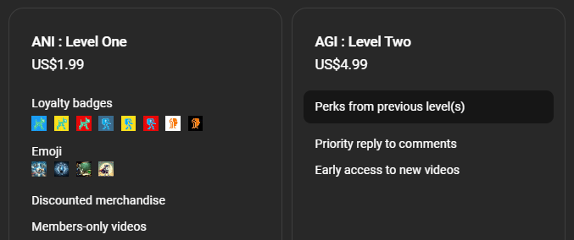

Membership has its privileges
Notes:
https://www.youtube.com/channel/UC35ZpwldGw7ZJ5R-2sLijzw/join

Slide 3

Examining course information

Slide 4
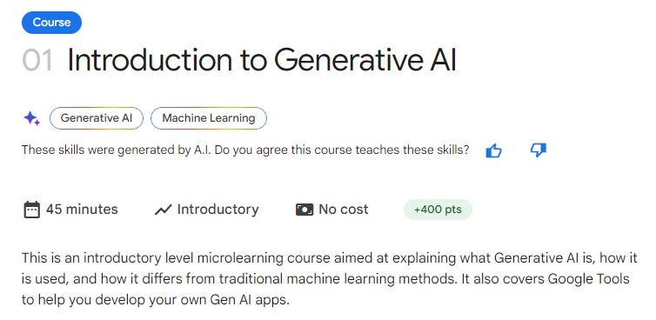

Slide 5
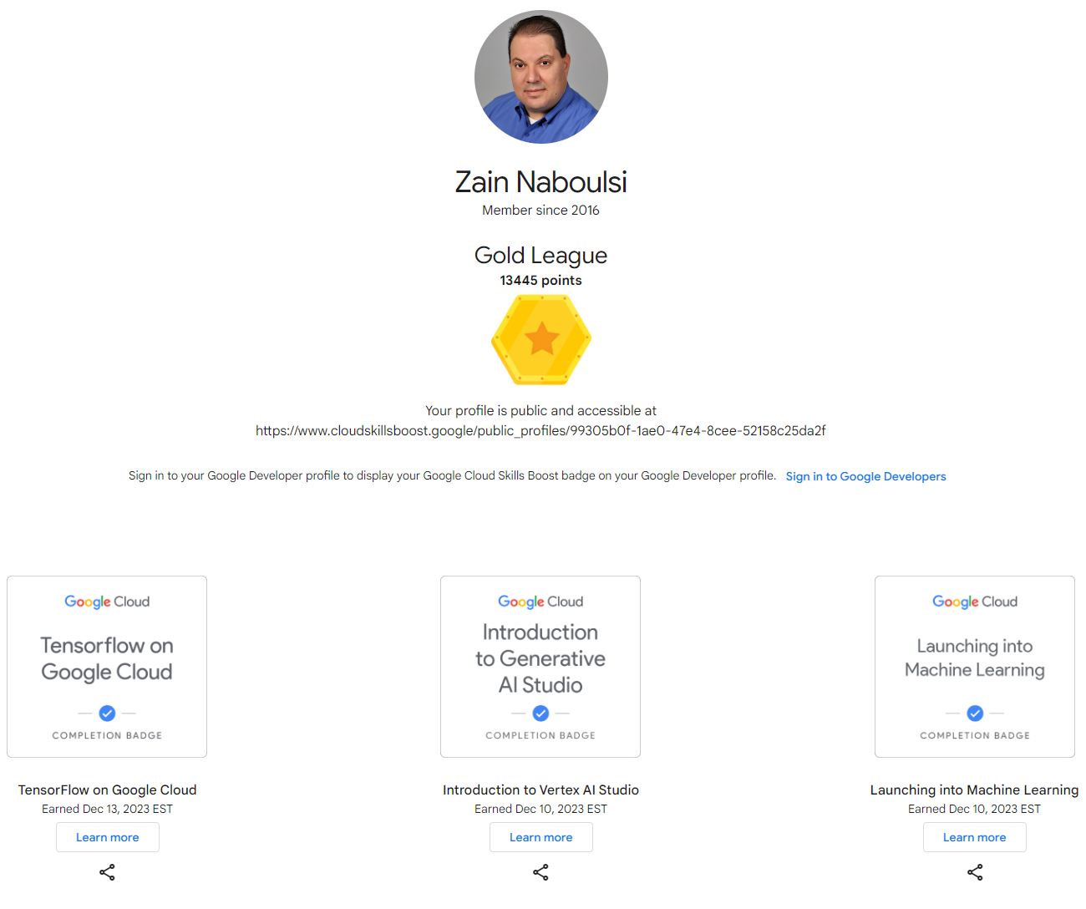
Point system and leagues
Notes:
https://www.cloudskillsboost.google/public_profiles/99305b0f-1ae0-47e4-8cee-52158c25da2f

Slide 6
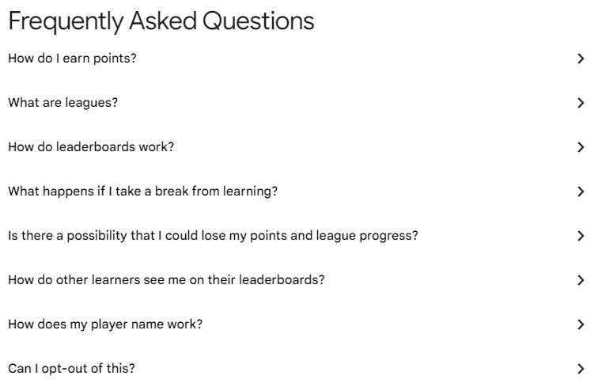

Slide 7


Slide 8


Slide 9

Going through the course

Slide 10
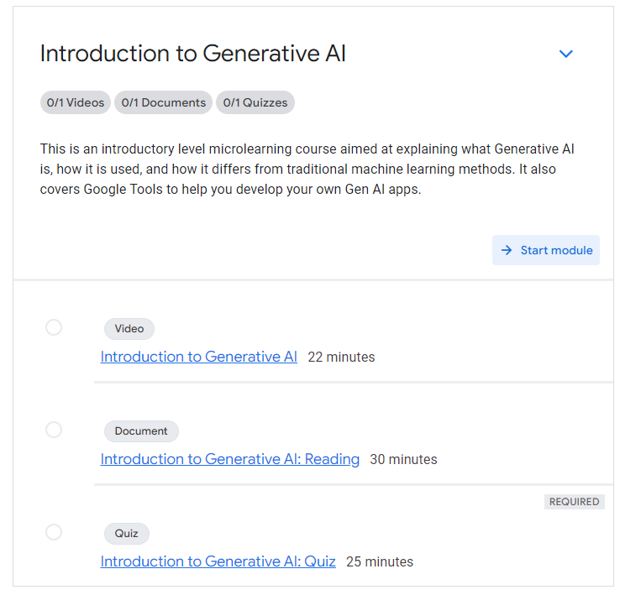

Slide 11
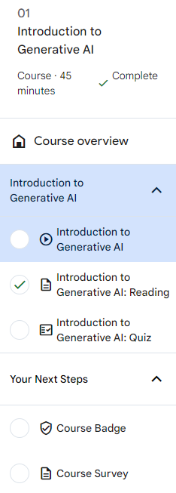
Tracking progress

Slide 12

Moving on

Slide 13
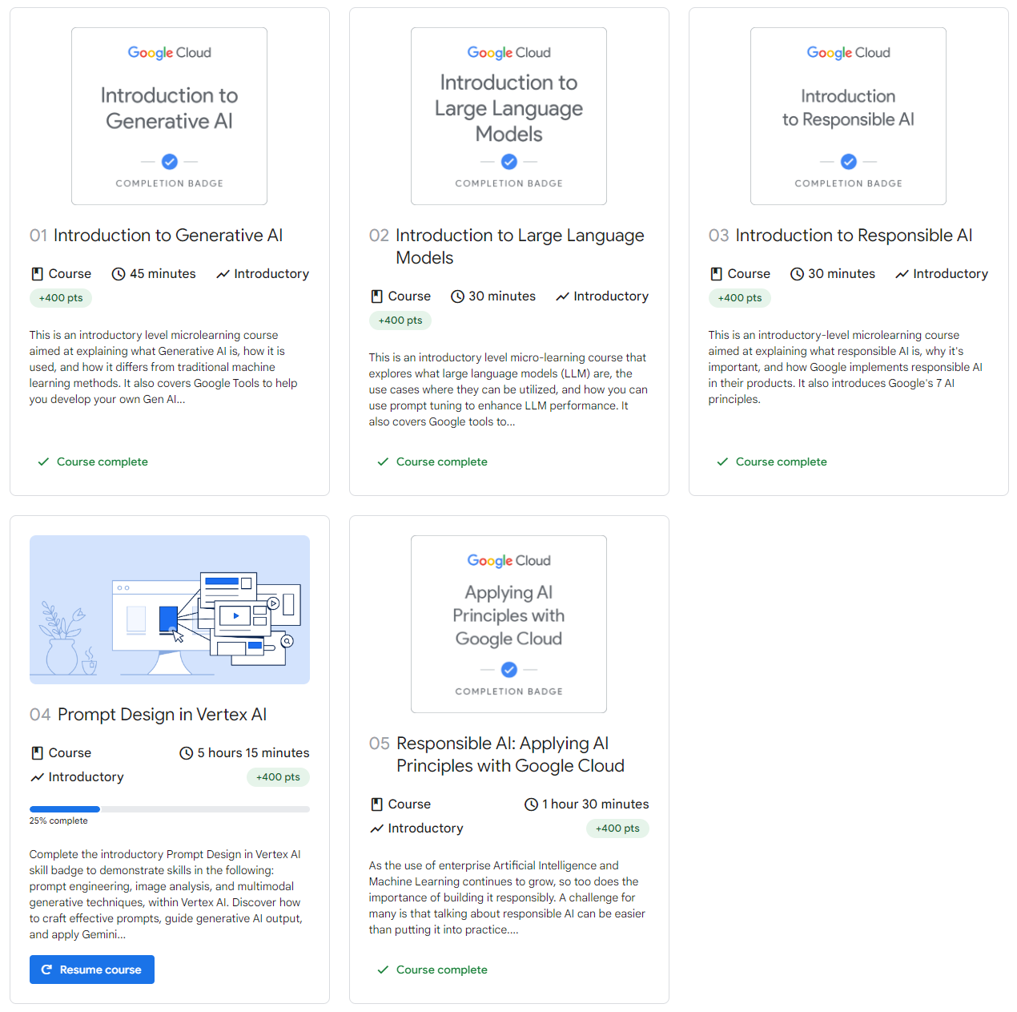

Slide 14


